Slide 1
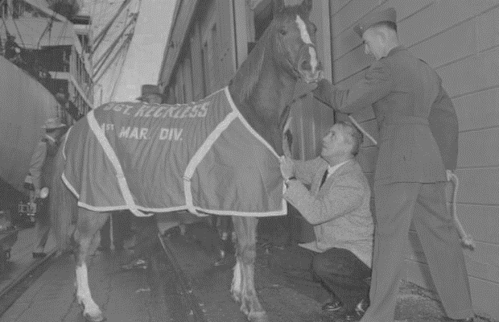
H&S Bn, HQMC Henderson Hall
Back in the Saddle (BITS)
30 Jan 2022
Command Safety

Slide 2
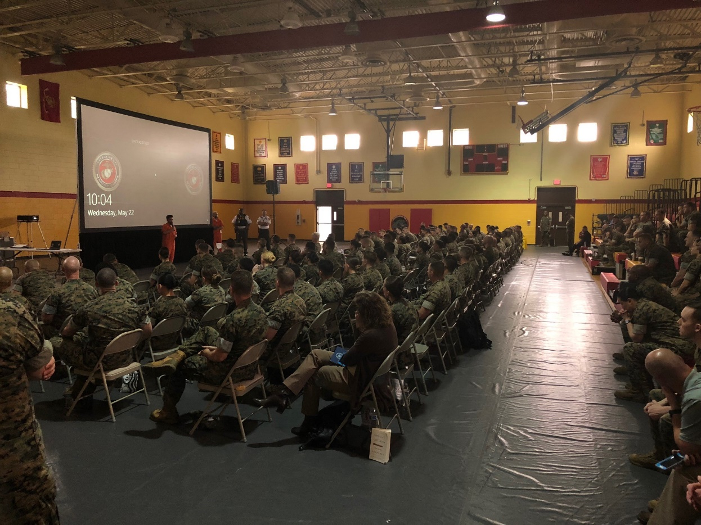
Overview
Safety Wave-Tops
Situational Awareness
Need to Know Stats
Force Preservation
Local Rounds
Notes:
Back in the Saddle (BITS)

Slide 3
History Lesson: Staff Sergeant Reckless
Staff Sergeant Reckless - Primary trainer was Platoon Gunnery Sergeant, Joseph Latham.
Reckless earned several awards.
Only horse in US history to have been promoted to the rank Staff Sergeant.
Bought for $250 in 1952 by a US Marine Corps lieutenant at Seoul Race Track from a young Korean boy who needed the cash to buy his sister an artificial leg, the small horse would become America's greatest war horse.
The Marines called her Reckless, after the recoilless rifle for which she carried ammunition. The cannon was often dubbed the "reckless" rifle because it was so dangerous to handle.
Reckless played an important role during the Battle of Outpost Vegas in the final stages of the Korean War between US and Chinese armed forces in March 1953
Reckless, whose military decorations included two Purple Hearts, received a hero's welcome when she was shipped from Korea to the US in 1954, with hundreds of people awaiting her arrival in San Francisco.
Having twice been promoted to staff sergeant, Reckless would spend the rest of her life at Camp Pendleton in California, where she gave birth to one filly and three colts, according to History.com.
Although her death in 1968 was front page news in the US, and she was buried with full military honors, the horse had become somewhat of a forgotten hero in the decades that followed

Slide 4


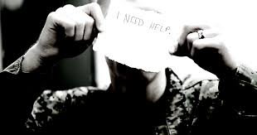

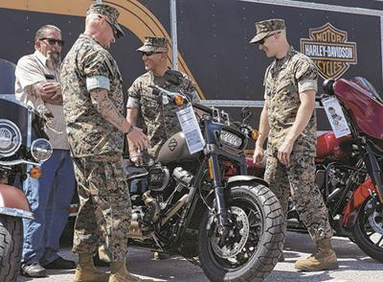


Safety, It’s what we do!
Safety Checks News Letters
Safety for Families
HQMC Civilian Workforce
Force Preservation
Information and Safety App
Motorcycle Club
Wellness
Training

Slide 5
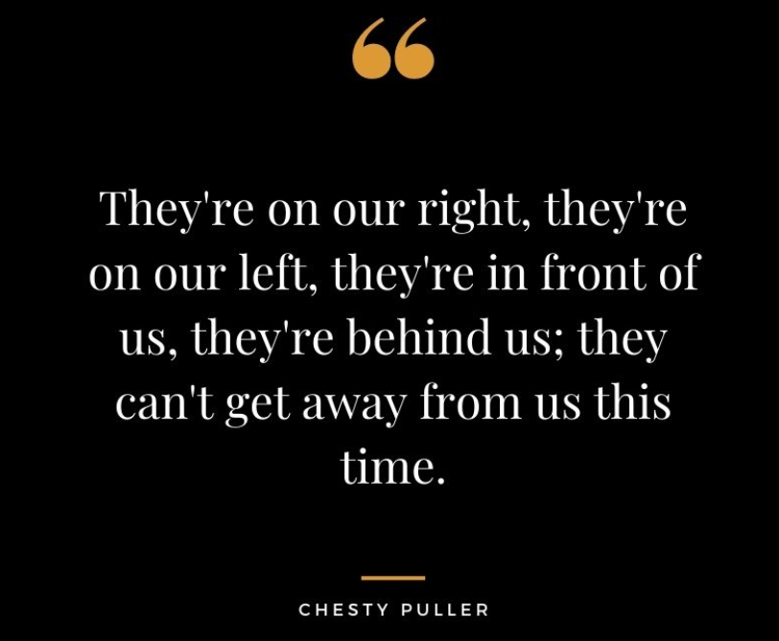
Situational Awareness
Knowing what is happening around you and knowing where you are in relation to the things around you allows you to anticipate changes in your environment and adjust or react accordingly.
It's important to look where you're going, watch what you're doing and pay attention to your surroundings.
A distraction is anything that prevents you from giving your attention to something else.
When you're engaged in any task or project, focus on what you're doing.
Follow workplace policies on earbuds and headphones to ensure you can hear directions, alarms and announcements while working.
Properly secure your gear, tools and hand-held equipment so you can focus on the job without constantly re-securing loose items or adjusting your PPE.
Put the phone down and pay attention to what you're doing.
Notes:
Before we get into our mishap stats I wanted to take a moment to touch on situational awareness.
Bullet two: Many mishaps involving injury or death could have been prevented if the person or others involved were paying attention to what they were supposed to be doing.
Bullet 3: Tasks needing our focus include daily activities as mundane as walking up the pier or into the office, to those that require more intensive concentration and focus, such as loading, clearing or firing a weapon, performing a medical procedure, flying an aircraft or just troubleshooting an electrical issue.
Bullet 4: Avoid engaging in non-task-related discussions when the task calls for it. For example, the gun range is not the place for joking,
Bullet 7: We know texting while driving is literally a crash waiting to happen, but plenty of trips, falls and head injuries (from walking into things) occur because people are texting or looking at their phone while walking

Slide 6

Mishap Stats and Comparisons
You Need to Know
Enterprise Safety Updates
Notes:
Mishap Stats need to know information. These stats that will be shown on the upcoming slides are public information

Slide 7
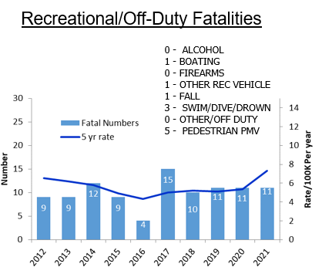
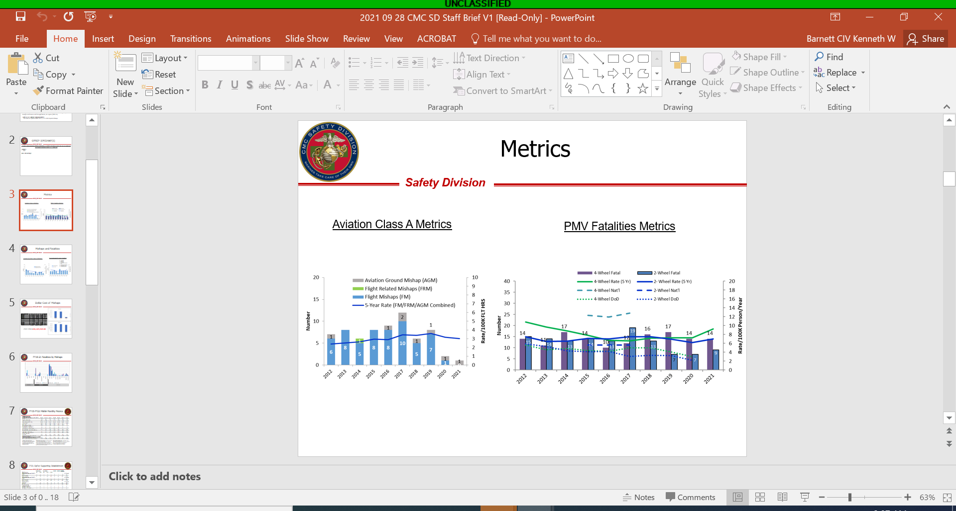
Enterprise Mishap Stats and Comparison

Slide 8
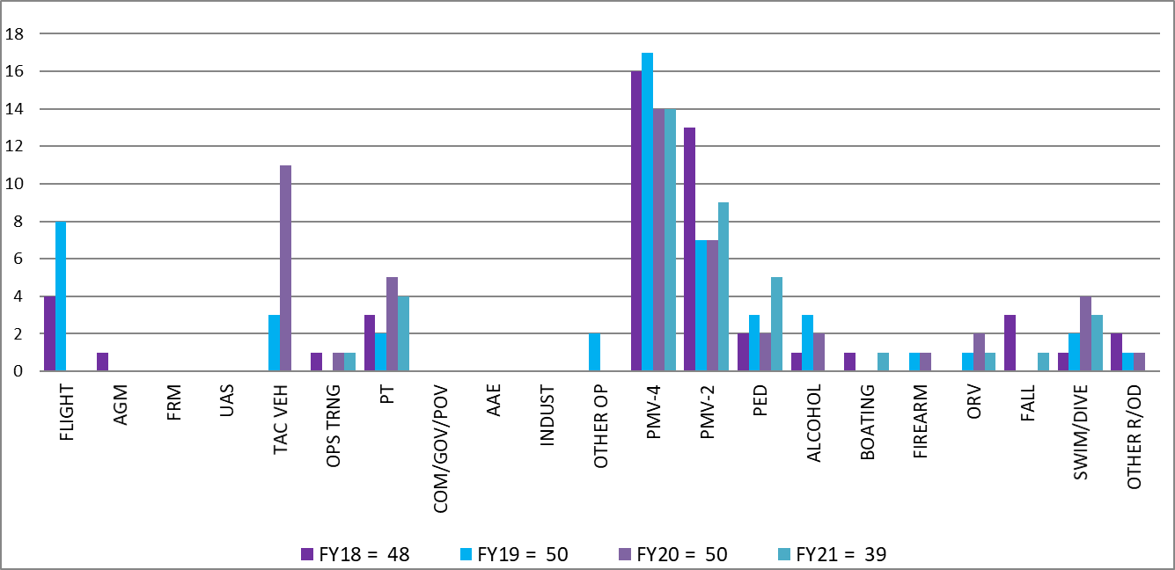
Enterprise Mishap Stats and Comparison
FY18-21 Fatalities by Mishaps
Aviation
On-Duty
Off-Duty

Slide 9
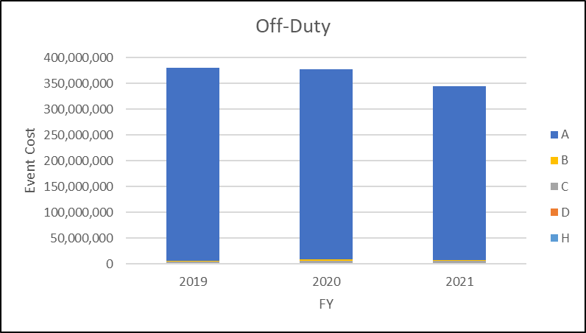
Costs Associated to Mishaps

Slide 10


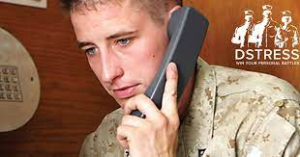
Force Preservation
Data pulled for FY21
32 suicides (total)
  15 Supporting establishments
275 attempts (total)
  87 Supporting establishments
1157 ideations (total)
  452 Supporting establishments
MCCS Services
Force Preservation Council

Slide 11
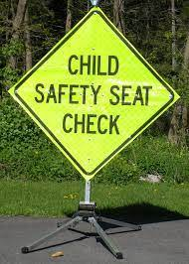
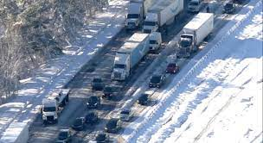
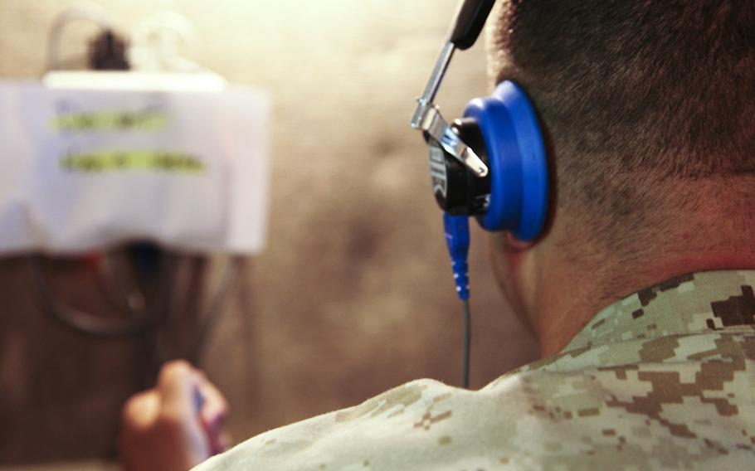

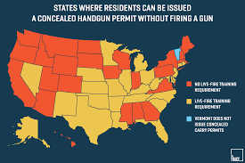
Local Rounds
* Still Impacted by Winter * Hearing Readiness * PT injuries
* Concealed Weapons Permits * Continue to Report all Mishaps.
* Safety - Boots on the Ground * MCO 5100.29C
* Child Safety Seat Checks

Slide 12
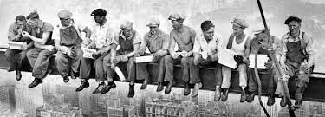
Questions?
Make the right decisions! Your family, your leadership,
and fellow Marines are counting on it!

